Slide 1
React JS
(Class components)
Lecture- 10

Slide 2
Today’s Agenda
Two Types Of Components
Class Components
How To Create Class Components
Industry Recommended Way Of Structuring A React Application

Slide 3
Two Types Of React Component
As discussed previously, React lets us define components in two ways:
Using Functions and are called as Function based components
Using Classes and are called as Class based components
Till now we have discussed about Function based components and now we will understand Class based components.

Slide 4
How To Create A Class Based Component ?
To create a class based Component we need to take 2 steps:
Create your own class that extends the React.Component class
Define the render() method which must return your component

Slide 5
Step 1:
Extending The Component Class
As mentioned previously , we must extend the React.Component class in our class as shown below
class App extends React.Component {
.......
}

Slide 6
Why Extending React.Component Is Needed ?
In React, by extending the React.Component class, we
can pass props to our component.
inherit methods from React.Component class, like the lifecycle methods (componentDidMount(), componentDidUpdate(), componentWillUnmount(),and most importantly the method render()).
can set state of a class based component using the setState() method

Slide 7
Step 2:
Define The render() Method
The method render() is the only required method in a class component.
It is seen as a normal function but render() has to return something whether it is null.
When the component file is called React automatically calls the render() method by default because that component needs to display the HTML markup or we can say JSX .

Slide 8
What Can render() Return ?
When called, the method render() should return one of the following types:
React elements. Typically created via JSX.
Fragments. Let’s us return multiple elements from render.
Portals. Let’s us render children into a different DOM subtree.
String and numbers. These are rendered as text nodes in the DOM.
Booleans or null. Render nothing.

Slide 9
Step 2:
Override The render() Method
class App extends Component {
render(){
return <h1>Hello, World!</h1>;
}
}

Slide 10
Exercise
Create a Class Based React component that returns the message Hello User Jee!

Slide 11
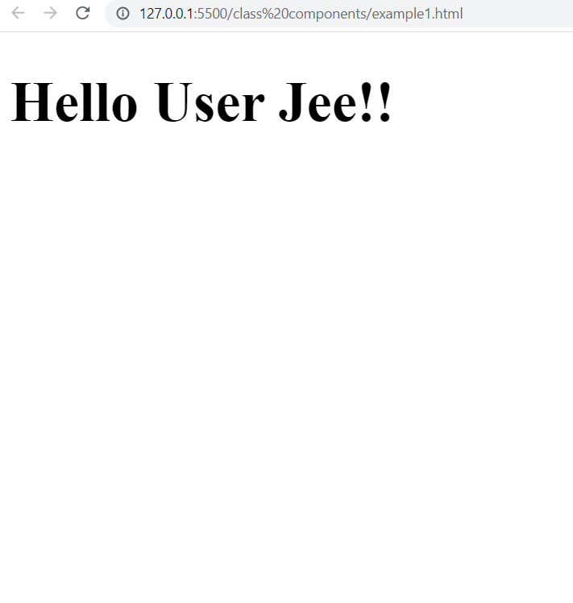
Exercise

Slide 12
Solution:
index.html
<body>
<div id="root"></div>
<script type="text/babel">
class App extends React.Component {
render() {
let myElement = <h1>Hello User Jee!!</h1>;
return myElement;
}
}
let mydiv = document.querySelector("#root");
ReactDOM.render(<App />, mydiv);
</script>
</body>

Slide 13
Changes Done W.R.T. React 18
We might have noticed that when we use React 18 and call the method ReactDOM.render() we get a warning message which says that we must use createRoot() instead of ReactDOM.render() in React 18.
This is because React 18 introduces a new root API for rendering our components.

Slide 14
Changes Done W.R.T. React 18
This new root API which provides better control for managing roots.
The new root API also enables concurrent rendering , that will let React prepare many versions of the UI at the same time.

Slide 15
Changes Done W.R.T. React 18
Previous code:
let myDiv = document.querySelector("#root");
ReactDOM.render(<App />, myDiv);
New code:
let myDiv = document.querySelector("#root");
let root = ReactDOM.createRoot(myDiv);
root.render(<App />);

Slide 16
Improved Solution
index.html
<body>
<div id="root"></div>
<script type="text/babel">
class App extends React.Component {
render() {
let myElement = <h1>Hello Userjee!!</h1>;
return myElement;
}
}
let myDiv = document.querySelector("#root");
let root = ReactDOM.createRoot(myDiv);
root.render(<App />);
</script>
</body>

Slide 17
Exercise
Rewrite the previous React component using external JavaScript

Slide 18
Solution
index.html
<!DOCTYPE html>
<html lang="en">
<head>
<script
crossorigin
src="https://unpkg.com/react@18/umd/react.development.js"
></script>
<script
crossorigin
src="https://unpkg.com/react-dom@18/umd/react-dom.development.js"
></script>
<script src="https://unpkg.com/@babel/standalone/babel.min.js"></script>
<title>Class based react element</title>
</head>
<body>
<div id="root"></div>
<script type="text/babel" src="App.js"></script>
</body>
</html>

Slide 19
Solution
App.js
class App extends React.Component {
render() {
let myElement = <h1>Hello User Jee!!</h1>;
return myElement;
}
}
let mydiv = document.querySelector("#root");
let root = ReactDOM.createRoot(myDiv);
root.render(<App />);

Slide 20
React Layout
Now we are going to talk about the proper conventional layout for React.
We had been making a single component and we rendered it directly into the DOM.
This is good for learning basics of React but not at all an industry recommended approach

Slide 21
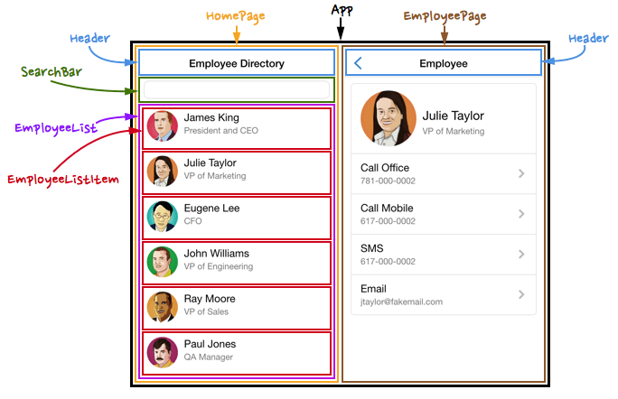
React Layout
Most of the React Apps we will build are always going have more than 1 component

Slide 22
React Layout
So its good to keep these components in separate files
Thus a general rule is :
ONE COMPONENT PER FILE with the file name as component name

Slide 23
React Layout
Finally we create our App component inside App.js file
This is our top level component and it combines all other components into a single component and renders it.
At last , inside our index.html we attach all the js files using <script> and they get rendered via App.js

Slide 24
React Layout
To display a “Hello There!!!” message on the screen. we will create the following file:
Hello.js
App.js
index.html

Slide 25
Hello.js
Hello,js
Here we have created our Hello component in a separate file and the file name is the same as the component name.
class Hello extends React.Component{
render() {
return <h1>Hello There!!!</h1>
}
}

Slide 26
App.js
App.js
class App extends React.Component{
render (){
return(
<div>
<Hello/>
</div>
)
}
}
let mydiv = document.querySelector("#root");
let root = ReactDOM.createRoot(myDiv);
root.render(<App />);

Slide 27
App.js
Now we have created our app component in the App.js file.
It combines our other components into a single element.
And then we rendered it into the DOM.
So the App.js file is an entry point in our code.

Slide 28
index.html
<!DOCTYPE html>
<html lang="en">
<head>
<meta charset="UTF-8">
<meta http-equiv="X-UA-Compatible" content="IE=edge">
<meta name="viewport" content="width=device-width, initial-scale=1.0">
<title>App Layout Demo</title>
<script src="https://unpkg.com/react@18/umd/react.development.js"></script>
<script src="https://unpkg.com/react-dom@18/umd/react-dom.development.js"></script>
<script src="https://unpkg.com/babel-standalone@6.15.0/babel.min.js"></script>
</head>
<body>
<div id="root"></div>
<script src="Hello.js" type="text/babel"></script>
<script src="App.js" type="text/babel"></script>
</body>
</html>

Slide 29
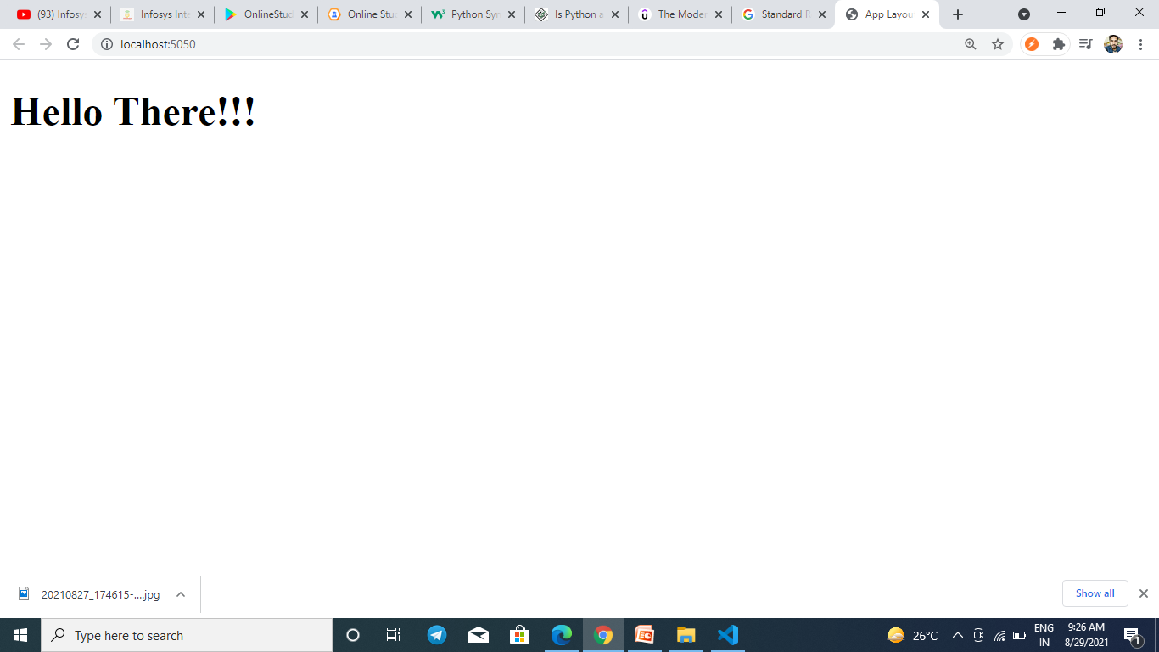
Output

Slide 30
Final App Layout
Hello.js
Bye.js
class Hello extends React.Component
{
render(){
.......
}
}
class Bye extends React.Component
{
render(){
.......
}
}
App.js
class App extends React.Component
{
render(){
return (
<div>
<Hello />
<Bye />
</div>);
}
}
index.html
<html>
…….
<script src=“Hello.js” type=“text/babel”></script>
<script src=“Bye.js” type=“text/babel”></script>
<script src=“App.js” type=“text/babel”></script>
</html>

